Slide 1


Troubleshooting Guide
Placing System in Bypass

Slide 2
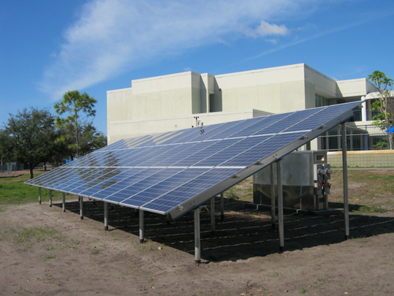
Contents
Important Information Before Starting
Checking the Power
Bypass Switch
Activating Bypass Switch
Finishing Up
Checking Load
Inspection
Notes:
The contents of this troubleshoot were created for facility personnel with little to no experience in electricity or solar.
1. Before beginning any troubleshoot, there is important information that must be looked over to ensure a seamless process. Like knowing the type shelter, where the load panel is located, and how to access the system.
2. We look at the issue at hand, is the receptacle not working or is the light not turning on at the shelter.
3. We locate the bypass switch at the enclosure/shed
4. Activating the Bypass switch
5. Put everything back and finish up
6. Check the load by seeing if the receptacle or light switch are in normal working order
7. Scheduling an inspection with a solar professional to look over any faults at the system

Slide 3
Important Information Before Starting
Vocabulary
What area is designated as the shelter within the school?
What is powered inside the shelter?
System components
  Which are important to me?
  Where are they?
Where is the PV system located?
Notes:
There is important information a person must know before beginning any troubleshoot.
The terminology used in this guide is typical jargon used by electricians and/or solar experts. A quick rundown of this vocab is beneficial in understanding what is being said or knowing the different names when referring to the same component.
Other important information that has to be know before the trouble shoot is where is the shelter located in the school? Is it a gym, cafeteria, or a set of classrooms?
What is powered by the PV system inside the shelter? Which lights, which receptacles, and which bathrooms?
Which components are important to me during this troubleshoot?
Where is the photovoltaic system on school grounds?

Slide 4
Vocabulary
the components (battery, inverters, charge controllers, etc.) needed to make the energy from the PV array usable
another name for power from utility
electrical panel powered by PV
components powered by the PV system
another name for main electric panel
Balance of System (BOS)
Electric Grid
Emergency Critical Load Panel
Emergency Loads
Grid Critical Load Panel
Notes:
The vocabulary used in this guide can sometimes be a lot and challenging for an individual with minimal experience. Here is a list of a few vocabulary words and what they mean that will come up in the guide. Become familiar with these words or reference when needed.

Slide 5
Vocabulary
Inverter
Loads
Normal/Standby Switch
Photovoltaic (PV) System
Uninterruptable Power Supply (UPS)
device that turns solar or Direct Current (DC) energy to usable Alternating Current (AC) energy
Items that use electricity
another name for the bypass switch
solar electric system
automated backup electric power to a load when utility fails
Notes:
The vocabulary used in this guide can sometimes be a lot and challenging for an individual with minimal experience. Here is a list of a few vocabulary words and what they mean that will come up in the guide. Become familiar with these words or reference when needed.

Slide 6
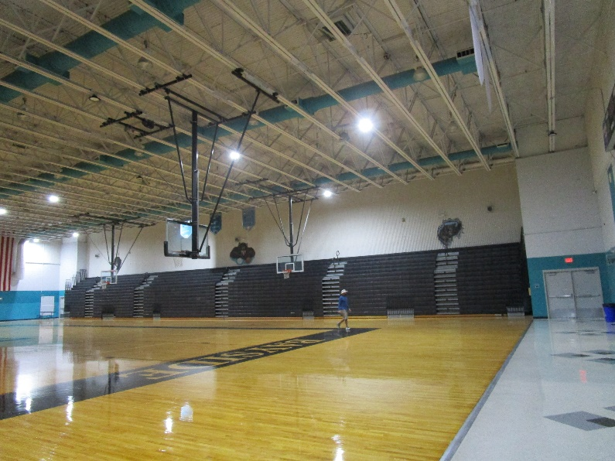
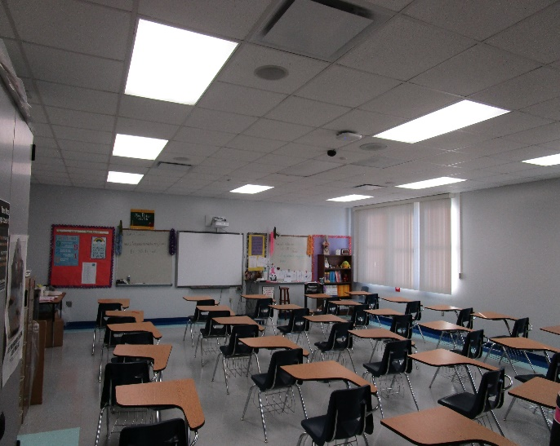
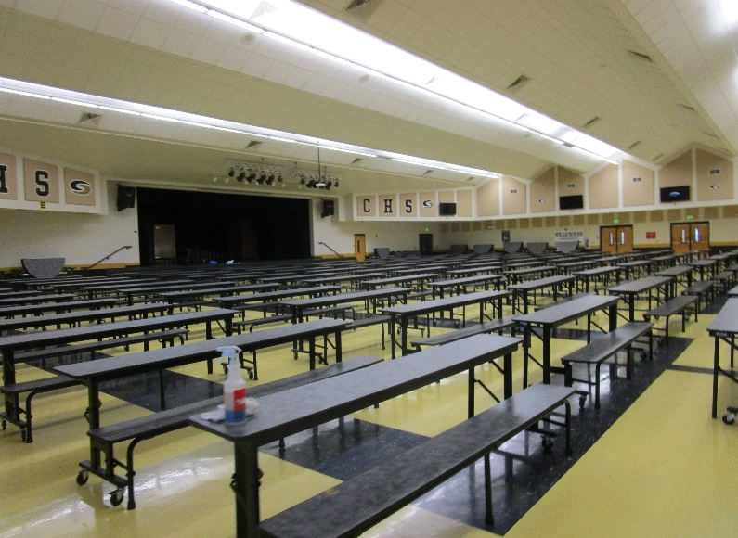
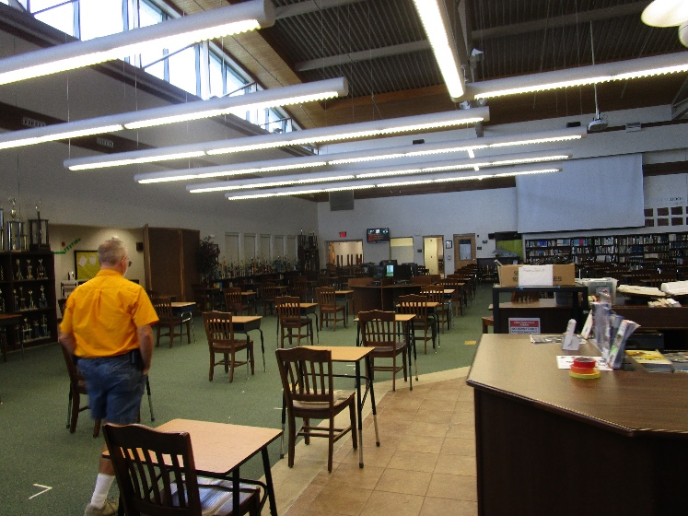
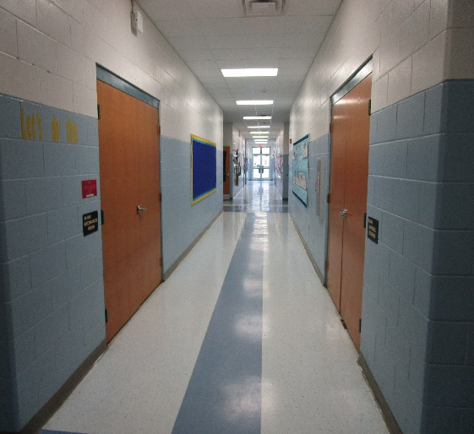
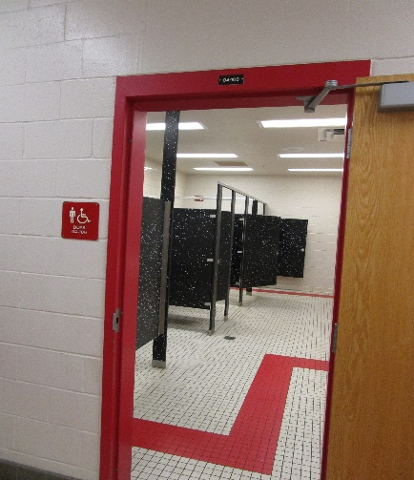
What area is designated as the shelter?
Gym
Classroom
Cafeteria
Bathrooms
Library
Notes:
What part of the school has been designated as the emergency shelter?
Gym
Cafeteria
Set of Classrooms
Library
And which bathrooms have been selected for the shelter.

Slide 7
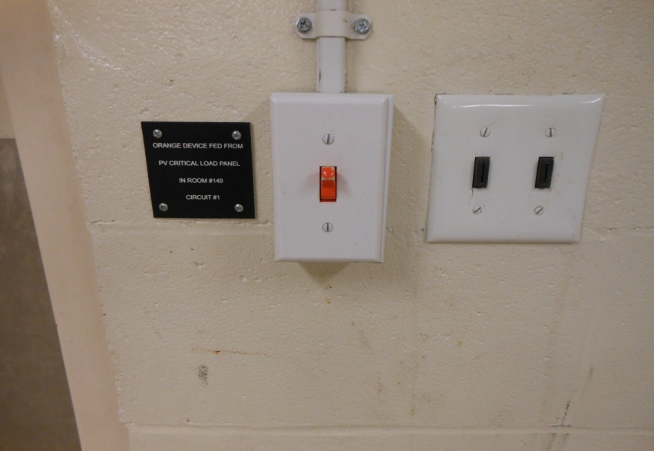
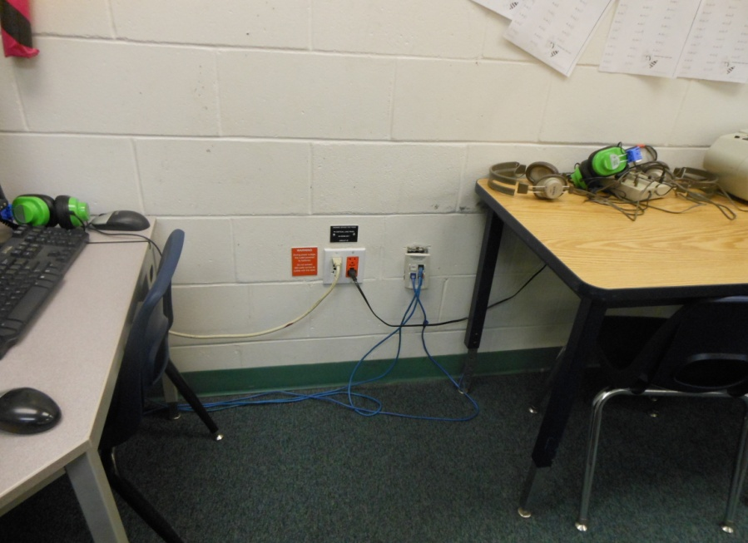
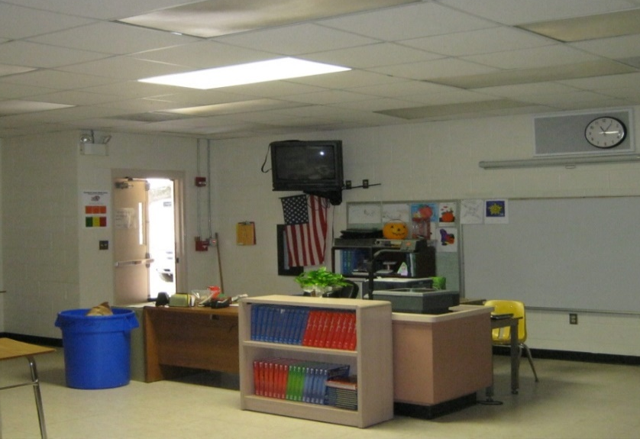
What does it power?
Light switch with Label
Light On
Receptacle-outlets with Label
Notes:
The PV system powers a few lights and receptacles inside the emergency shelter.
In the emergency shelter, there will be black, red, or orange labeling on receptacles and light switches powered by the PV system.
The switches and receptacles may also be a different color, such as orange or red.
Because the lights are so high on the ceiling, proper labeling on the lights themselves was impractical. The only way to know for certain which lights are powered by the PV system is to flip the light switch labeled “Powered by PV” and see which lights turn on and off. This is important because you need to know if you are working on a light that is powered by the PV system or the utility. There is no point in continuing with troubleshooting if the component being affected is powered by the grid and not the PV system.

Slide 8
Important Components
Notes:
Important components for the system are:
What?
Load Panel
Loads
Receptacle and Switches
PV System
Balance of Systems (BOS)
Bypass Switch
Why?
It is important to know where these components are because you will be doing the majority of the troubleshoot in these areas.
Where?
The components for the PV system are generally in the same area. The electrical room that houses the critical load panel is the electrical room in the school that is closest to the PV system and so forth.
We will go into detail for what, why, and where is it.

Slide 9
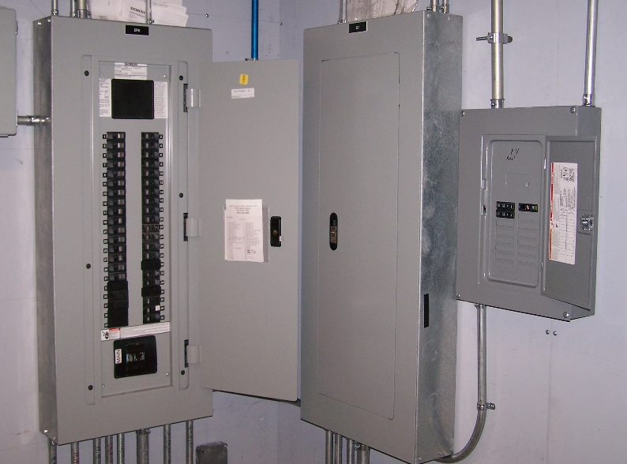
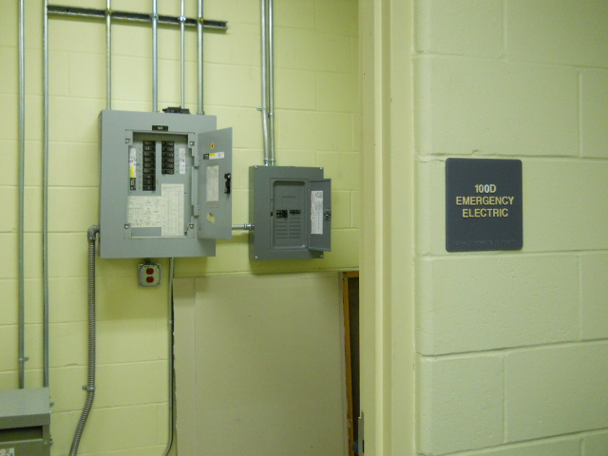
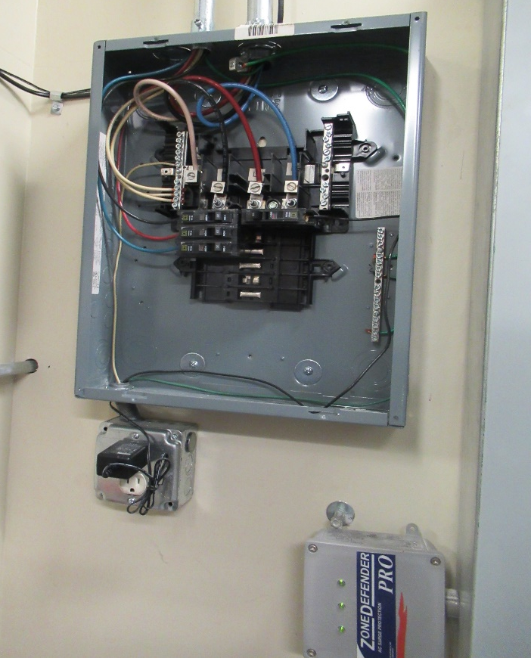
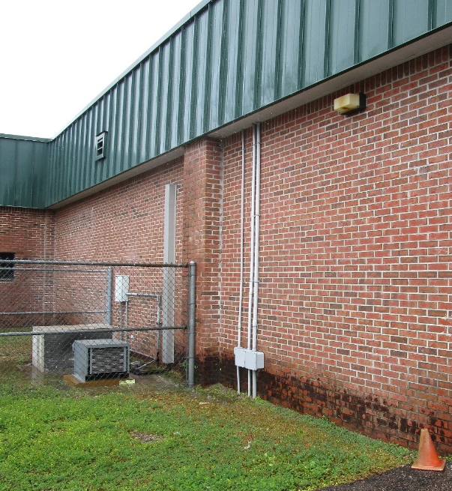
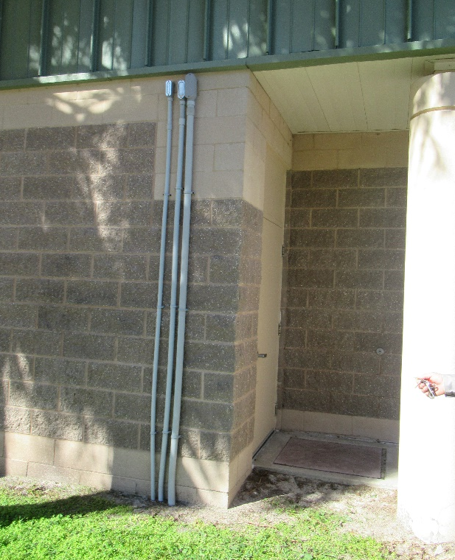
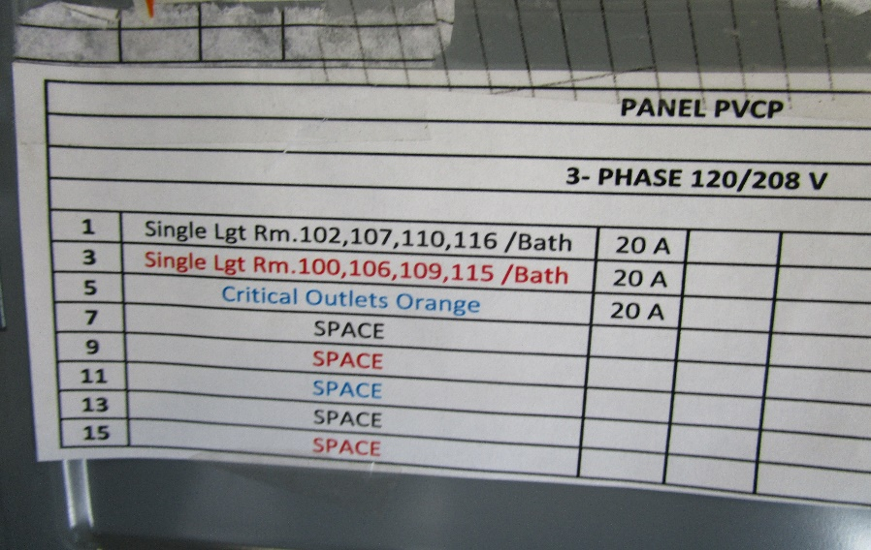
Critical Emergency Load Panel
Receptacle-outlets with Label
Notes:
The load panel (blue box) and the critical load panel (red box) share the same name but are different in that the critical load panel is a piece of hardware that functions as a second electrical panel; it is a component of an energy storage installation. It is the panel that is powered by the PV system. The load panel, on the other hand, also known as the fuse box or electrical panel, distributes the electricity from the utility and not the PV system.
The critical load panel is found in the electrical room closest to the PV system. If you are standing at the PV system, look at the buildings closest to the system because conduit (green box) runs from the system to a building at the school. Not all the conduits into the school look the same but the two photos of the conduit are typically what are at the schools. Some may differ by being shorter and lower to the ground.
Note: Not all critical load panels will be like the photos, some may be further away from the load panel. The pictures used here are broad examples of what components may look like.

Slide 10
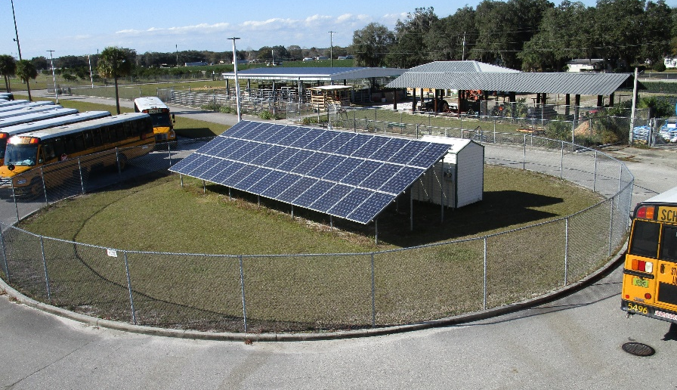
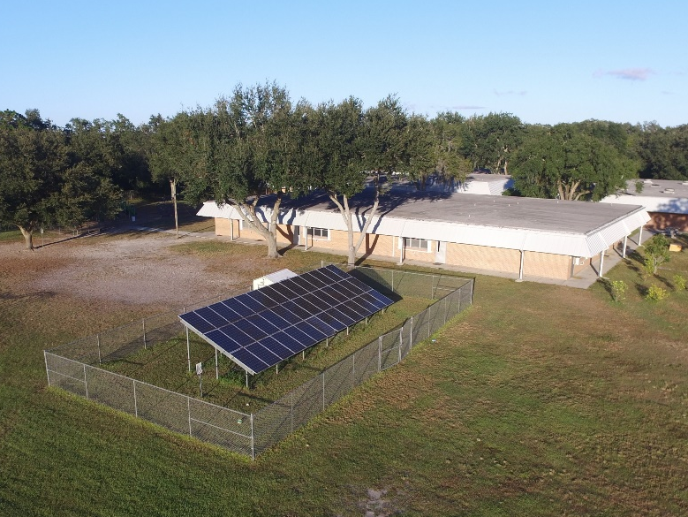
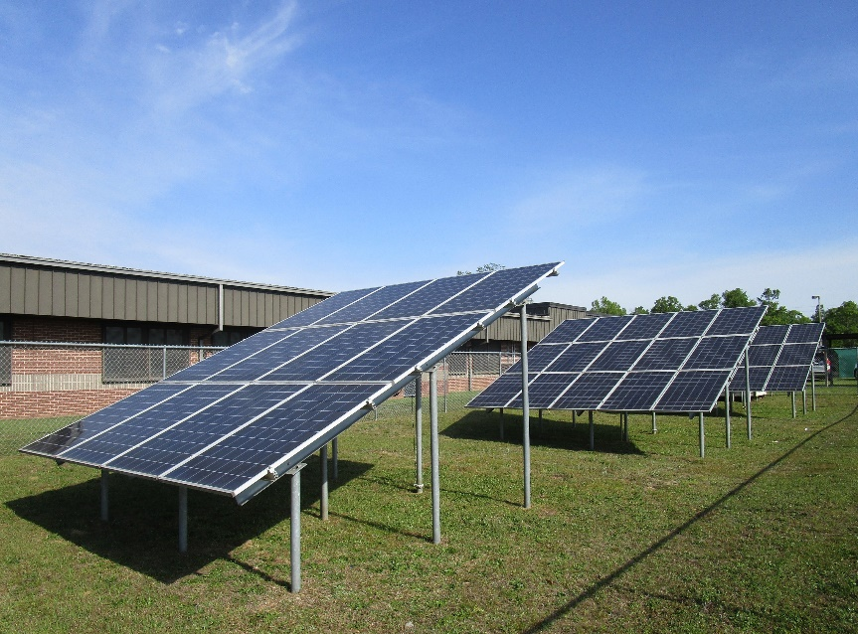
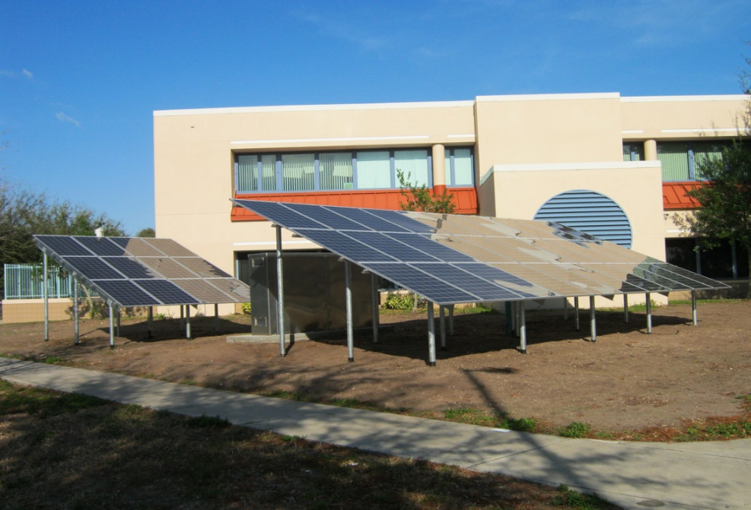
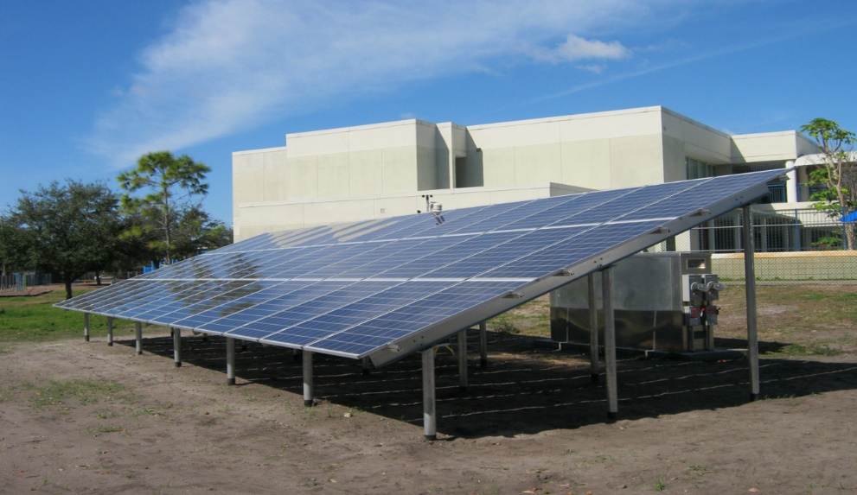
PV Systems
Notes:
The Balance of System can be an enclosure or a shed. The orientation of the array can differ at school because of the space allotted for the system. The location of the system can also vary by school. As you can see, at some schools the array is in the front of the school like the bottom right hand picture. At some schools, the system is kept toward the back of the school like the two photos on the left. Sometimes the arrays can be in unique areas like the photo of the bus loop or the picture in the middle where the system is kept in the middle of the school.
Regardless of where the system is located, knowing where the system is located is crucial because it will help you locate the electrical room and they bypass switch at the system.

Slide 11
Checking the Power
Notes:
There is an issue with the receptacle or lights powered by the PV.

Slide 12
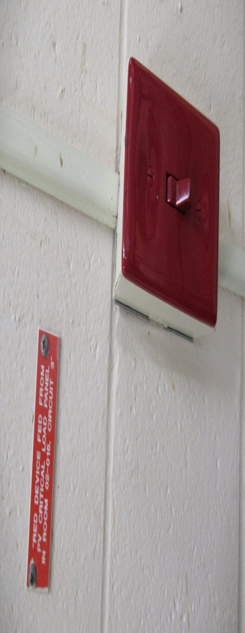
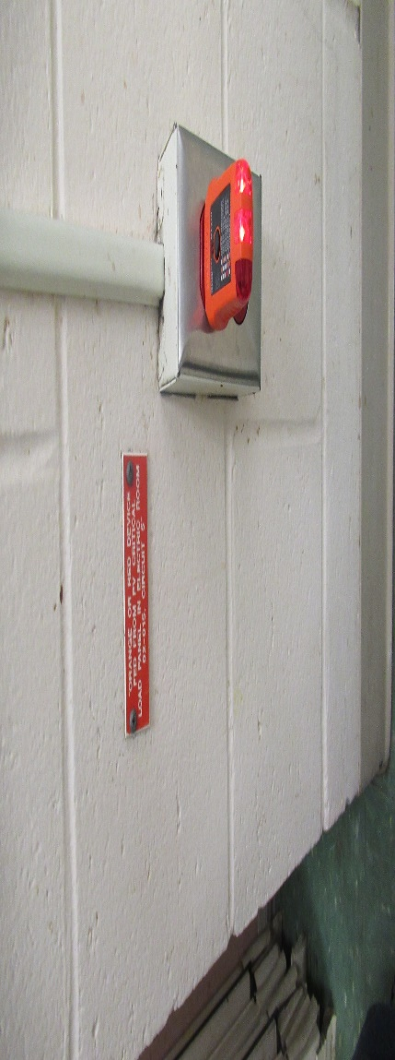
No Power
Plug into power outlet labeled “Powered by PV”
Flip Switch labeled “Powered by PV” on and off
Notes:
First thing to do if you are having electrical issues due to the PV is to check the labeled receptacle and/or light switches with their corresponding light.
Plug something into the receptacle to see if it works like the photo at the top. The picture shows a receptacle checker but a phone and charger can do the same. We are just seeing if you are able to place a load on the receptacle.
If a light is out, than we must flip its corresponding switch to see if any other lights connected on the same circuit turn on because you just may have a dead bulb that needs replacing. You also want to see if the light that is out is powered by the PV because that is what this guide is concerned about.
If you are certain that the receptacle or light switch is connected to the PV, then we need to move to the critical load panel to see if for whatever reason the breaker at the CLP tripped.

Slide 13
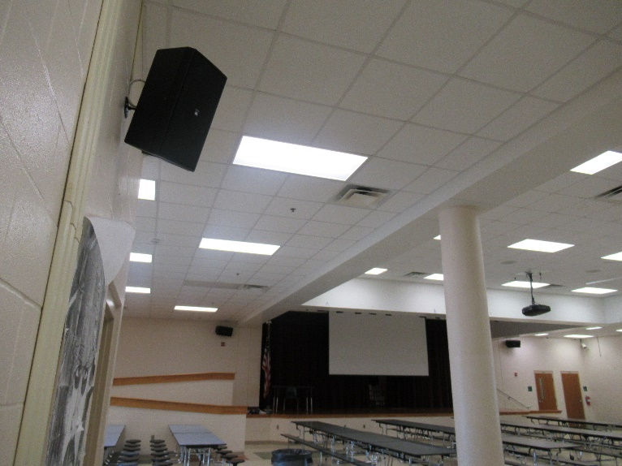
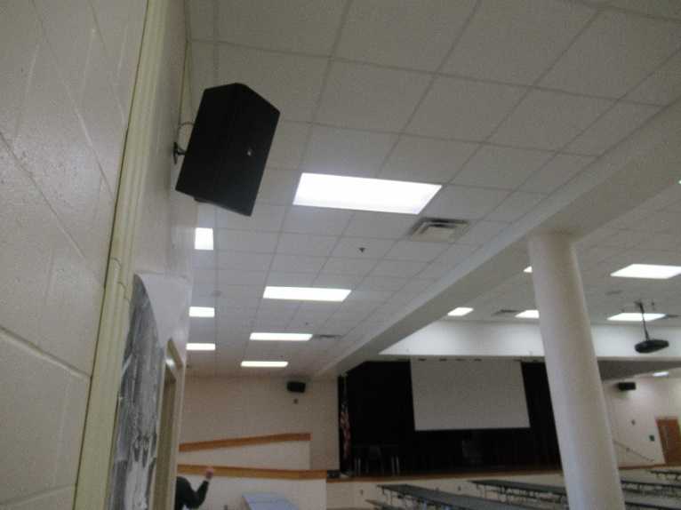
Power On
Light goes from off to on
Notes:
First thing to do if you are having electrical issues due to the PV is to check the labeled receptacle and/or light switches with their corresponding light.
Plug something into the receptacle to see if it works like the photo at the top. The picture shows a receptacle checker but a phone and charger can do the same. We are just seeing if you are able to place a load on the receptacle.
If a light is out, than we must flip its corresponding switch to see if any other lights connected on the same circuit turn on because you just may have a dead bulb that needs replacing. You also want to see if the light that is out is powered by the PV because that is what this guide is concerned about.
If you are certain that the receptacle or light switch is connected to the PV, then we need to move to the critical load panel to see if for whatever reason the breaker at the CLP tripped.

Slide 14
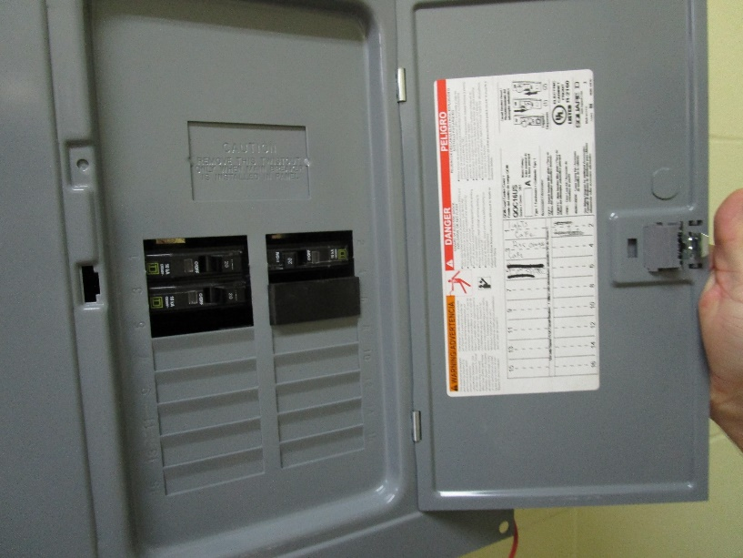

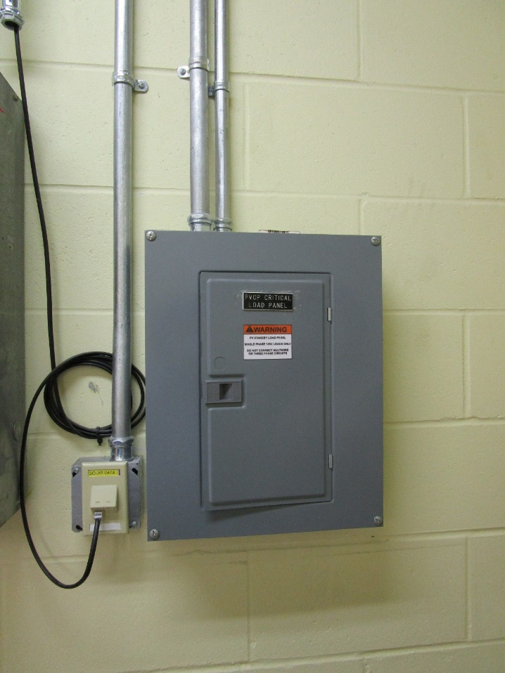
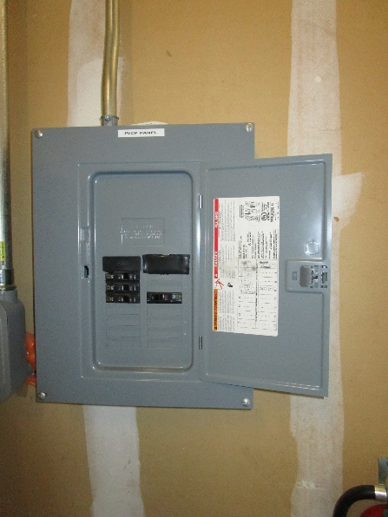
Emergency Critical Load Power Panel
Notes:
Once again, the variation of PV components location, orientation, and installation varies through each school. The school you may be working at can resemble some of the photos shown in this powerpoint but the concepts are the same.
The CLP will have each breaker labeled to what they power. Look for the label that corresponds to what you are working on. After locating the circuit that is having issues, reset the breaker if it has tripped. Once you reset the breaker, head back to the emergency shelter to check the light/receptacle that is having issues.
If resetting the breaker remedies the issue and you have power back on. Then you are done with your work getting the power back on and you don’t have to continue with the trouble shoot.
It may be beneficial to have a professional look at the system in case there is an issue at the BOS.
If flipping the breaker did not fix the problem, than more troubleshooting is needed, go to the next chapter.

Slide 15
Bypassing the System

Slide 16
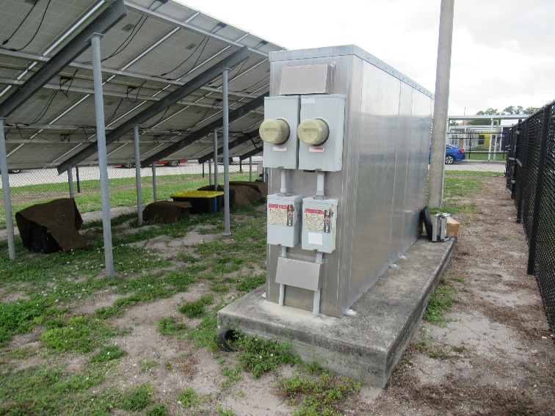
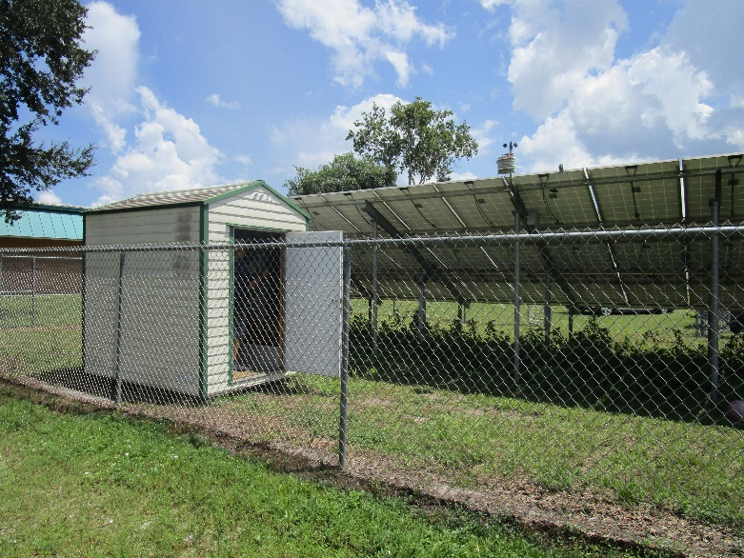
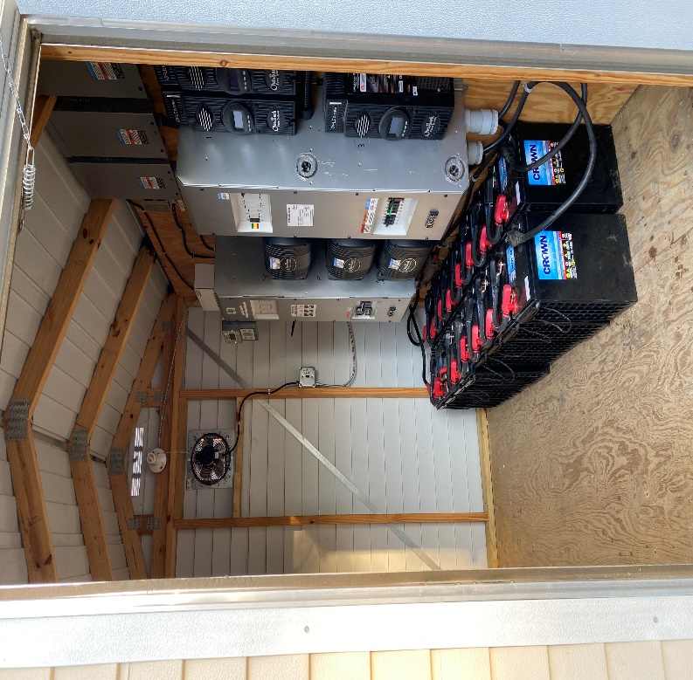
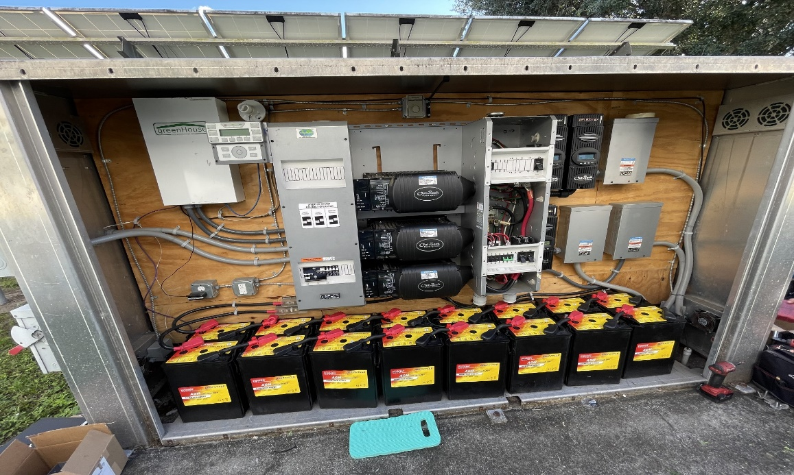
Bypass Switch is located with the BOS
Notes:
The BOS stands for Balance of System. This is where the components of the PV system take DC electricity created from the solar and turn into useful AC electricity that is sent to the emergency shelter to power the lights and receptacles.
The pictures show both the outside and inside of where the BOS is kept inside an metal enclosure or shed.

Slide 17

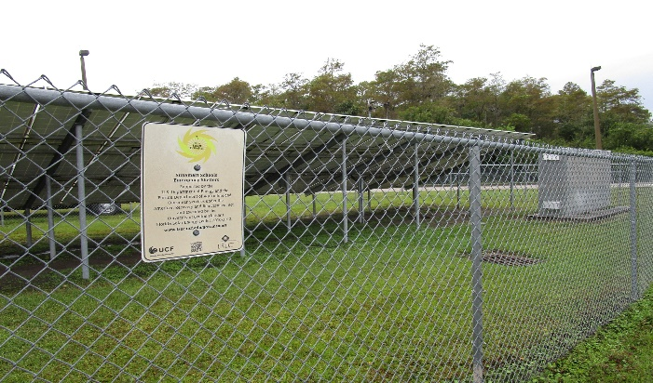
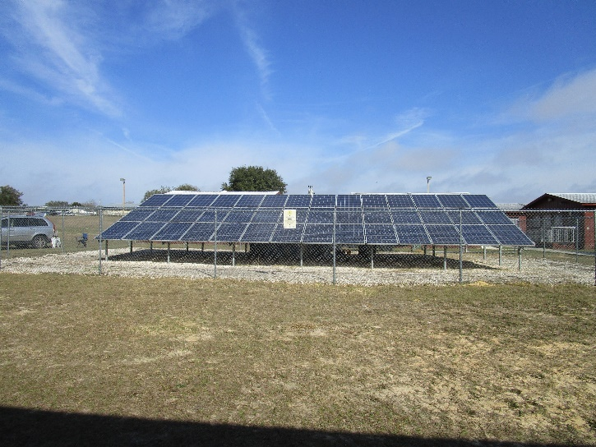
Getting to the PV System
System is housed behind chain link fence to prevent trespassing
Facilities personnel have the key to unlock the fence
Notes:
Like we mentioned at the beginning of the troubleshoot, identifying where the PV system is at the school is crucial as we go down the trouble shoot to bypass the PV system.
The system is kept behind a locked gate to prevent children from getting injured and to prevent theft. The key for the lock is typically the same key used for other locks around the school.

Slide 18
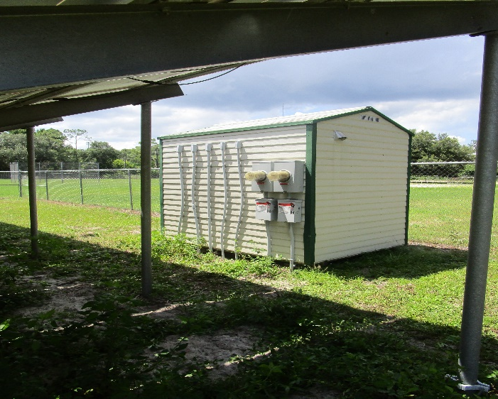
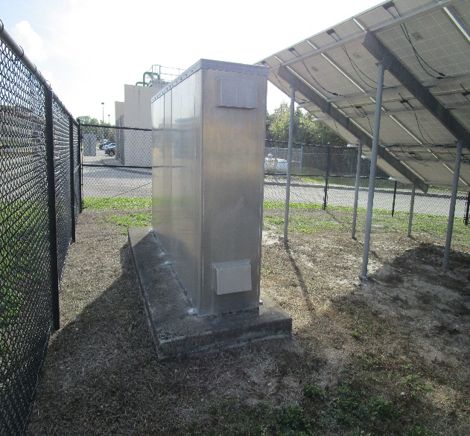
Where are the BOS components housed?
Enclosure
Shed
Notes:
Your school will have either an enclosure and a shed.
This is important because accessing the bypass switch in both is a different process.
We will walk you through into getting both systems

Slide 19
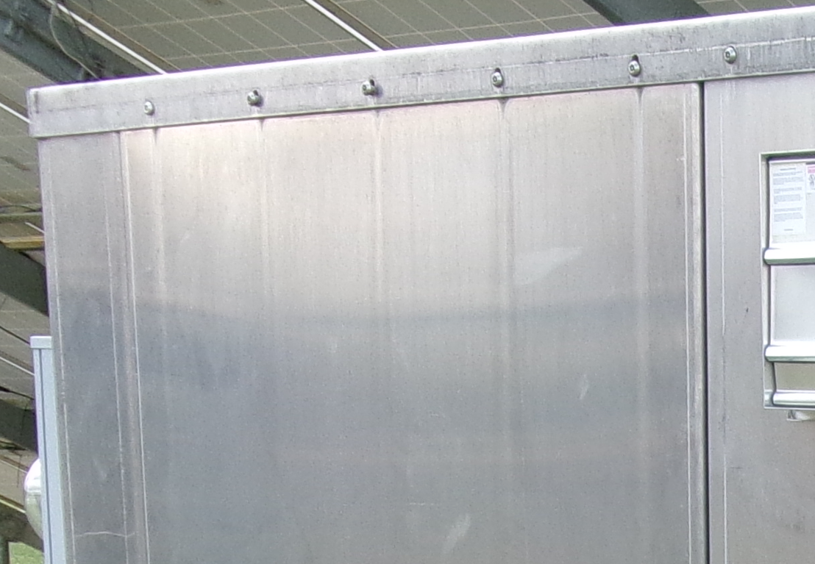
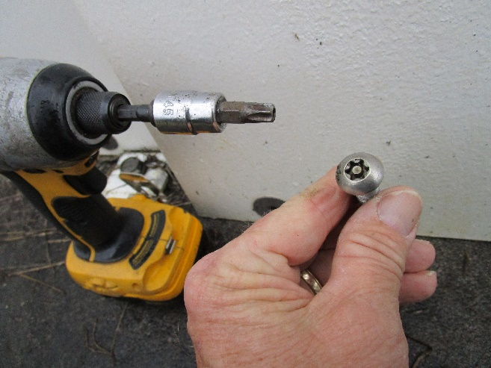
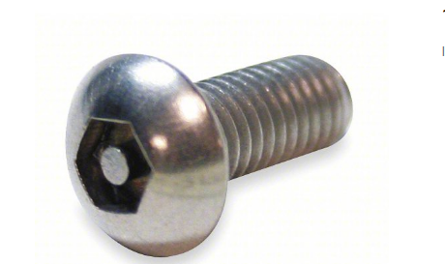
Enclosure
Enclosures are secured with a security bolt.
Torx Security Machine Screw
Hex Tamper Resistant Machine Screw
Notes:
The enclosure requires to open up the metal panels to access the inside.
Fortunately, to access the bypass switch, you will only need to remove the left panel when facing the enclosure.
The panel doors are secure with a torx security bolt or, in some special cases, a hex tamper resistant bolt

Slide 20
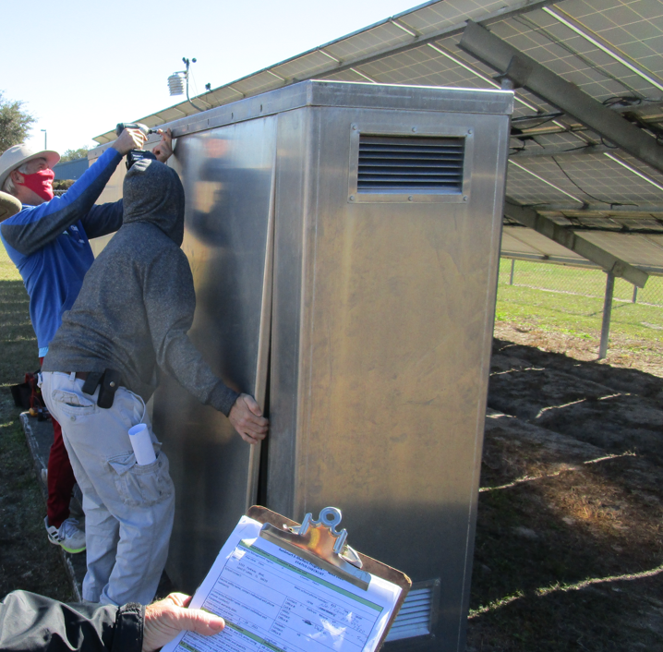
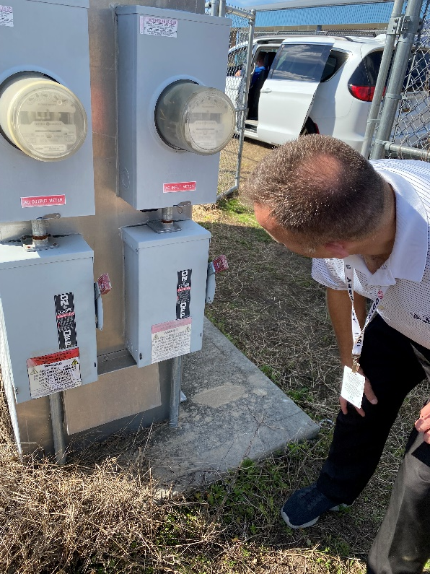
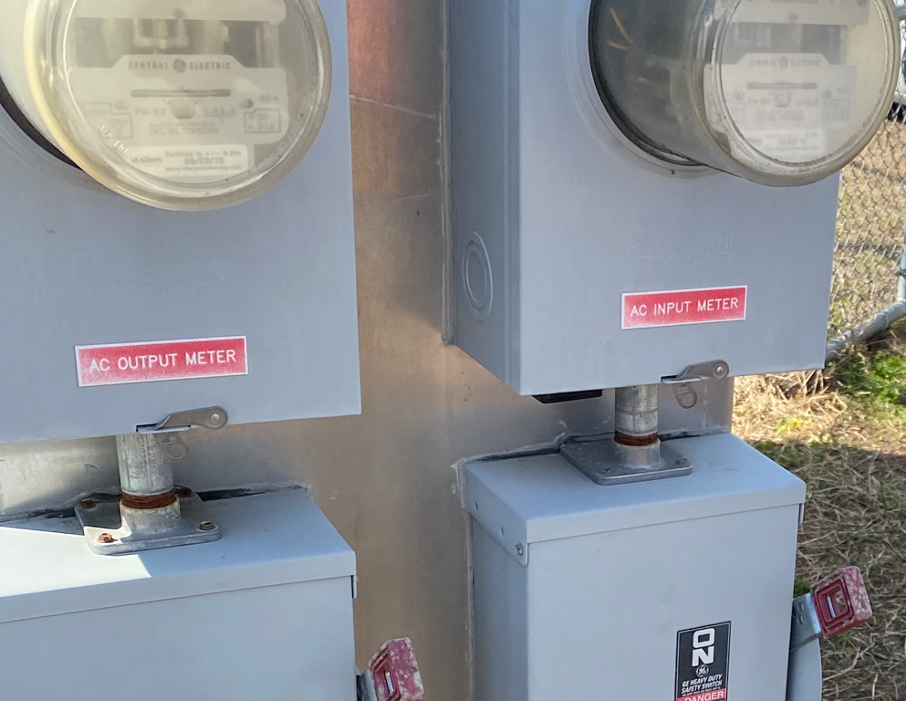
Enclosure (BOS)
Notes:
Underneath the power meter is magnetic key box. Inside the magnetic key box is a torx security bit or a hex tamper resistant bit, depending on your system, to remove the bolts off the panel doors. With the bit, you are able to access the BOS of system, remember only remove the left panel when facing the enclosure to access the bypass switch.
It is highly recommended to use a power drill to remove the bolts.
Caution: Due to the system being in natural elements, there may be some rusting and some sort of machine lubricant is recommended.
Also, when removing the panel after removing the security bolts, you may need to use a large flat head screw driver to pry the door by sliding it in between the panels.

Slide 21
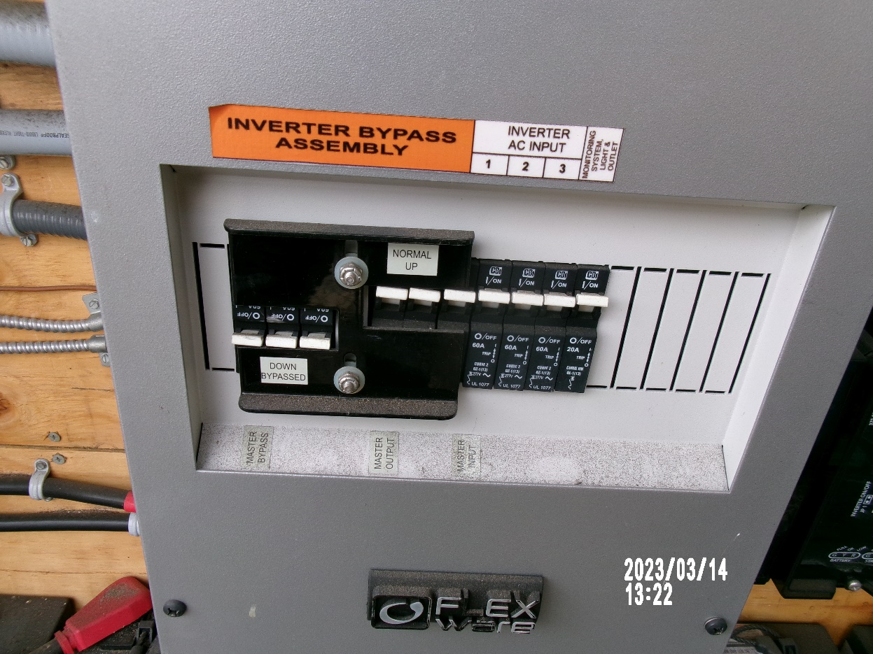
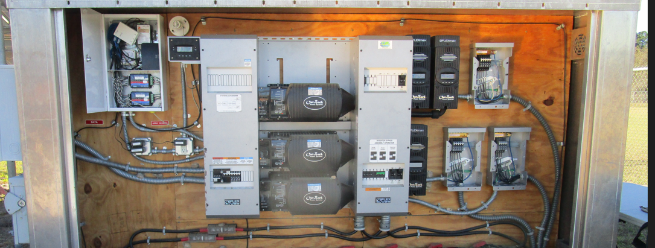
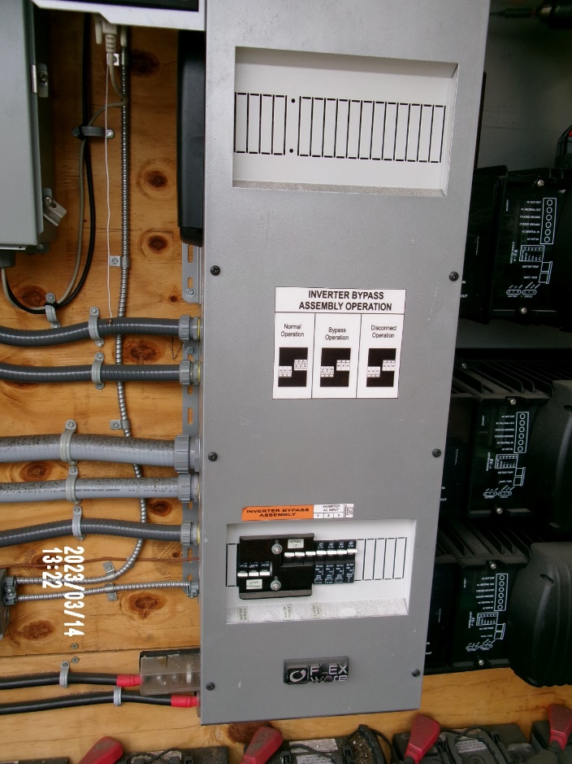
Enclosure (BOS)
Bypass Switch
Notes:
The top left photo is the enclosure with all the panels removed, to access the bypass switch, only the left panel needs to be removed. The arrow on the photo points to where the bypass switch is located.
The picture on the top right shows the system in normal operation, the bypass switch is not activated, the loads are powered by the PV system.
Once located, go to the next chapter, “Activating the Bypass Switch.”

Slide 22
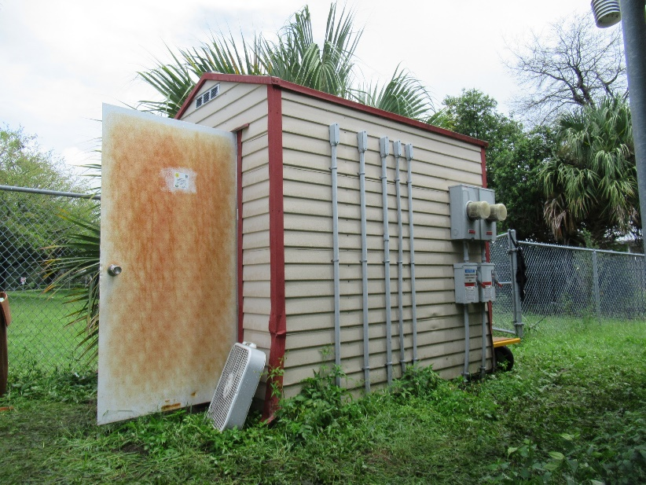
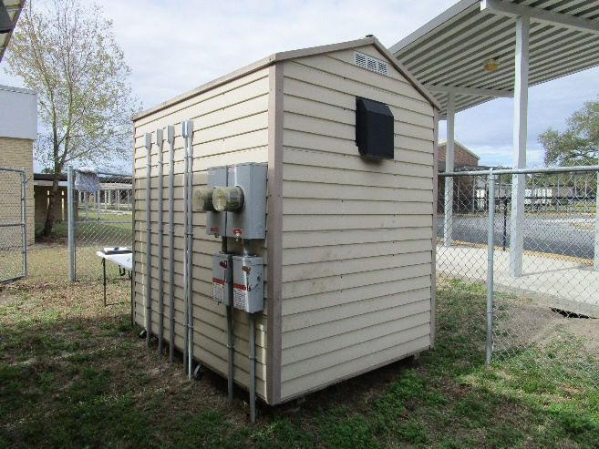
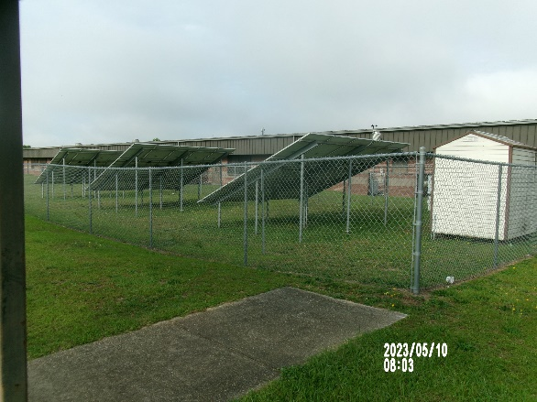
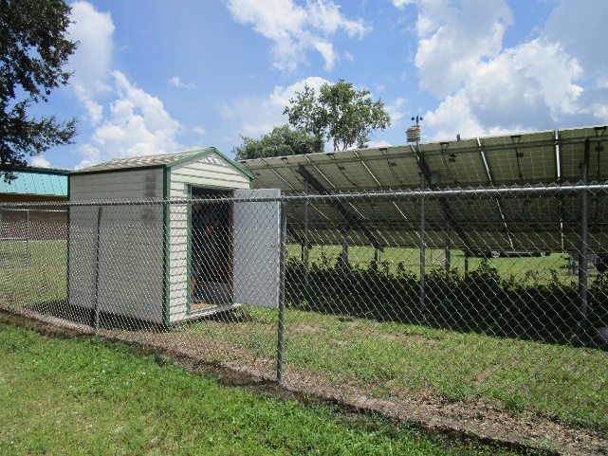
Shed (BOS)
Sheds are typically locked
Facilities' personnel should have a key to door
Notes:
The BOS is kept in a locked shed right next to the array. A facility manager will have the key to the door.

Slide 23

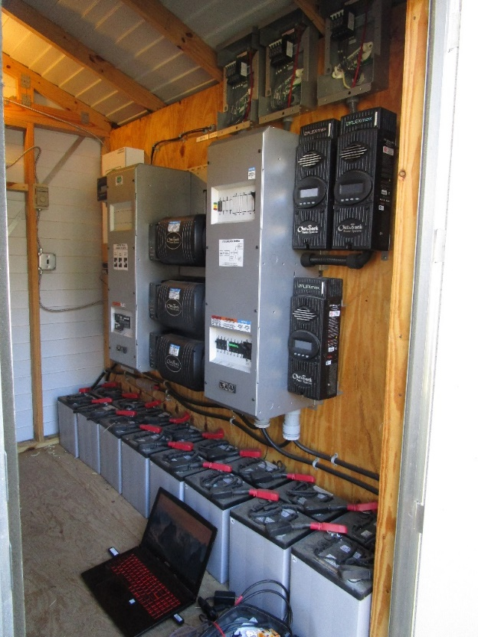

Shed (BOS)
Notes:
The bypass switch is located at the back of the shed. If you are inside the shed facing the BOS, bypass switch is located on the bottom left of the system.
The picture on the right has the bypass switch in its normal operation and the loads are being powered by the PV.
Once located, go to the next chapter, “Activating the Bypass Switch.”

Slide 24
Activating Bypass Switch
Notes:
Once the switch is located at your system, enclosure, or shed, we need to put it in bypass.
Caution: The bypass switch is designed to bypass the photovoltaic (PV) system and power the critical load panel with electricity from the utility. If your concern for bypassing the system is to get power at the receptacle or light switch, note that the PV system may have an issue and should be inspected by a trained electrician or solar professional. It is crucial for the PV system to be in normal operation and to ensure the battery parameters are met. The objective of the system is to keep the batteries charged in case of an emergency and power loss. If the system is failing and the batteries are not being charged, it can cause major damage to the batteries if they drop below a certain voltage.

Slide 25


Activating the Bypass Switch
Move black plate from “Normal – UP” position to down “Down - Bypass” position
MOVE: Up is PV ON, Down is UTILITY ON
Move Black Plate and Circuit Breakers
Together.
Notes:
By-Pass mode disconnects the PV system hardware and uses the utility grid to power the emergency loads through the emergency CLP. This switch is used when the PV system fails, but the utility is still working. You do not have to rewire the CLP to get the emergency lights work during normal times.
The system can be switched between normal mode (non-power outage) and standby mode (PV system not working).
When all of the PV system is working, leave this switch in Normal mode.
When in By-Pass mode and the DC power panel side is not working, then the batteries may not be charging and will go bad.

Slide 26
Activating the Bypass
PV Array
Electric
Utility
Battery
Storage
To-From
Utility
kWh
Net Metering
Critical
Emergency
Load
Panel
Inverter/
Conditioner/
Controller/
Charger
Building Main
Distribution
Panel
Emergency
AC Loads
Bypass circuit
Building
AC Loads
By-Pass Circuit – PV or Utility Power to
CLP Emergency loads at BOS
* Arrows indicate directions of power flows
Notes:
This chart shows how the PV no longer powers the critical emergency load panel. The loads are now powered by the utility.
This is another version of the basic diagram showing the functional relationship of the components and the function of the By-Pass switch energizing the emergency loads with utility power when the PV system is not working and the weather is normal. Notice the energy flow by the directional arrows and the position of the By-Pass switch. The By-Pass switch is in the BOS enclosure and used to bypass the PV system. Assume that the switch is in the Normal position when starting trouble shooting and the PV system is working.

Slide 27
Finishing Up
Notes:
Now that we have activated the bypass switch. We can place everything as we left it. Closing the enclosure will differ from closing the shed.

Slide 28



Finishing Up (Enclosure)
Notes:
Similar how we removed the metal panel off the enclosure, we will place the metal panel back onto the enclosure. It is recommended to use a power drill to drive the bolts. You may also need a sturdy screwdriver to hold up the metal panel to orient the panel to the threaded holes.

Slide 29


Finishing Up (Shed)
Notes:
After flipping the bypass switch, you can step out the shed and close the door. Just make sure it is locked once you are done in the shed.

Slide 30
Check the Load
Notes:
We go back to the emergency shelter and check if the receptacle or light regained power.

Slide 31



Check the Load
Notes:
The emergency critical load panel is no longer being powered by the PV. It is now powered by the utility.

Slide 32




Inspect and verify
Notes:
A thorough inspection needs to be done in order ensure that the PV system comes back to normal operation and is powering the critical emergency load panel.
The main focus of the system is to have batteries charged in case of an emergency and the utility goes down. The batteries can power the loads while utility comes back.
The batteries still can get charged even if the bypass switch is activated but a thorough inspection is advised to make sure the system is properly keeping the battery parameters met and the emergency critical load panel is being powered by the PV system.

Slide 33
For more information, contact:
SunSmart@fsec.ucf.edu
To learn more about the
SunSmart Emergency Shelter Max Project, visit:
www.sunsmartschools.org

